Slide 1
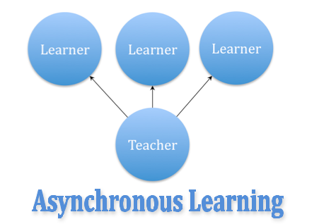
Asynchronous Processing
Writing Concurrent Code in C#
SoftUni Team
Technical Trainers
Software University
http://softuni.bg

Slide 2
Table of Contents
Synchronous Programming
Asynchronous Programming
Threads
Call Stack and Thread-Safety
Tasks in C# (async and await)
Data Parallelism & Concurrency
TCP Networking

Slide 3
Have a Question?
sli.do #csharp-web

Slide 4

Synchronous Programming
Benefits and Drawbacks

Slide 5
Synchronous Programming
Executing program components sequentially
i.e. "Sequential programming"
Actions happen one after another
Uses a single thread of a single process
Components wait for previous components to finish
Program resources are accessible at all points

Slide 6
Synchronous Code
static void Main()
{
int n = int.Parse(Console.ReadLine());
PrintNumbersInRange(0, 10);
Console.WriteLine("Done.");
}
static void PrintNumbersInRange(int a, int b)
{
for (int i = a; i <= b; i++)
{
Console.WriteLine(i);
}
}
int n = int.Parse(..)
PrintNumbersInRange()
Console.WriteLine(..)
...
Synchronous code is executed step by step

Slide 7
Synchronous Code - Long Running Operation
Console.Write("Enter your name: ");
string name = Console.ReadLine();
for (int i = 0; i < int.MaxValue; i++)
{
// Execute some operations here
}
Console.WriteLine($"Hello, {name}!");
You will have to wait for the long-running operation to finish before you can see the greeting

Slide 8
Synchronous Programming Drawbacks
If one component is blocked, the entire program is blocked
UI may become unresponsive
No utilization of multi-core systems
CPU-demanding tasks delay execution of all other tasks
Accessing resources blocks entire program
Especially problematic with web resources

Slide 9

Asynchronous Programming
Benefits and Drawbacks

Slide 10
Asynchronous Programming
Program components can execute in parallel
Some actions run alongside other actions
Each action can happen in a separate thread
Independent components don't wait for each other
Program resources shared between threads
If one thread uses a resources, others shouldn't use it

Slide 11
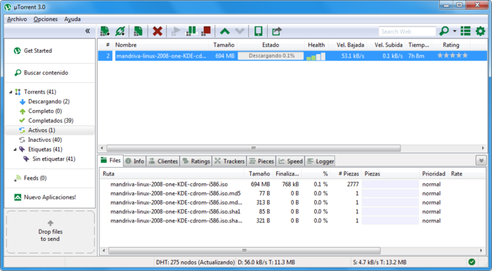
Asynchronous Programming – Benefits
If a component is blocked, other components still run
UI runs separately and always remains responsive
Utilization of multi-core systems
Each core executes one or more threads
CPU-demanding tasks run on "background" threads
Resource access runs on "background" threads

Slide 12

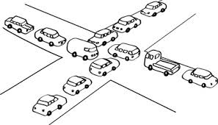
Asynchronous Programming – Drawbacks
Hard to know which code parts are running at a specific time
Harder than usual to debug
Have to protect resources
One thread uses a resource
Other threads must wait for the resource
Hard to synchronize resource access
Deadlocks can occur

Slide 13
Asynchronous Code
Asynchronous programming allows the execution of code simultaneously
int n = int.Parse(Console.ReadLine());
PrintNumbersInRange(0, 100);
var task = Task.Run(() =>
PrintNumbersInRange(100, 200));
Console.WriteLine("Done.");
task.Wait();
int n = int.Parse(..)
for (0..100)
Console.WriteLine(…)
for (100..200)
Wait()

Slide 14

Threads
Call Stack, Thread-Safety, Exception Handling

Slide 15

Instruction Execution
Each program's code is translated to CPU instructions
Program.cs
int a = 5;
int b = 4;
Console.WriteLine(a + b);
Compilation
Program.exe
Single-Core CPU
00DA2655 mov dword ptr [ebp-40h],5
00DA265C mov dword ptr [ebp-44h],4
00DA2663 mov ecx,dword ptr [ebp-40h]
00DA2666 add ecx,dword ptr [ebp-44h]
00DA2669 call 73B5A920
00DA266E nop
Instructions are executed one by one

Slide 16
Multi-Tasking
A computer can run many processes (applications) at once
But each CPU core can only execute one instruction at a time
Parellelism is achieved by the operating system's scheduler
Grants each thread a small interval of time to run
program.exe
chrome.exe
winamp.exe
system.exe
program.exe
...
0 5 10 15 20 25 ms
Notes:
s

Slide 17
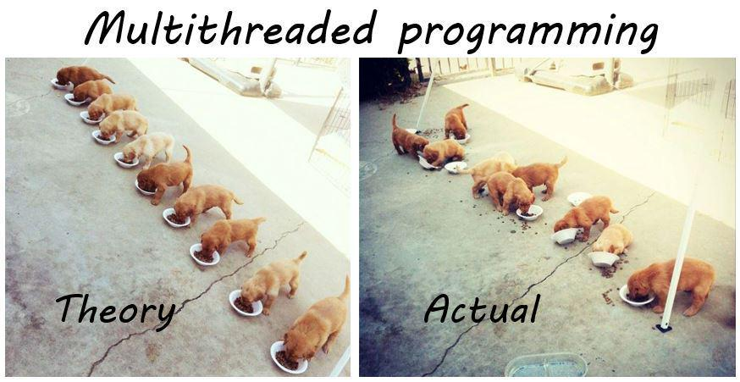
Threads
A thread is a fundamental unit of code execution
Commonly, processes (programs) use more than one thread
In .NET, there is always more than one thread (e.g. GC)
Each thread has a memory area associated with it known as a Call Stack
Stores local variables
Stores the currently invoked methods in order of invocation

Slide 18
Threads in C#
Threads in C# can be created using the System.Thread class
Constructor accepts a method (delegate) to execute on a separate thread
Thread thread = new Thread(() =>
{
for (int i = 0; i < 10; i++)
{
Console.WriteLine(i);
}
});

Slide 19
System.Thread
Start() – schedules the thread for execution
Join() – waits for the thread to finish its work (blocks the calling thread)
Thread primes = new Thread(() => PrintPrimesInRange(1, 10000));
primes.Start();
Console.WriteLine("Waiting for thread to finish work...");
primes.Join();

Slide 20
Problem: Even Numbers Thread
Print all even numbers in a given range
Printing should be executed on a separate thread
After all numbers are printed print "Thread finished work"
2
4
6
8
10
Thread finished work
1 10

Slide 21
Solution: Even Numbers Thread
// TODO: read start and end numbers
Thread evens = new Thread(() =>
PrintEvenNumbers(start, end));
evens.Start();
evens.Join();
Console.WriteLine("Thread finished work");
// TODO: implement method PrintEvenNumbers

Slide 22
Thread – Example
List<long> numbers = new List<long>();
Thread t = new Thread(() =>
SumOddNumbers(numbers, 10, 100000000L));
t.Start();
Console.WriteLine("What should I do?");
while (true)
{
string command = Console.ReadLine();
if (command == "exit") break;
}
t.Join();
Console interface
remains unblocked

Slide 23
Thread Stack
Each thread has its own stack
The start (bottom) of the stack is the method from which the thread began execution
Each method (frame) stores local variables
...
IsPrime()
PrintAllPrimes()
Main()
...
IsValidUrl
DownloadAsync
background thread
main thread

Slide 24

Thread Race Conditions
A race condition occurs when two or more threads access shared data and they try to change it at the same time
List<int> numbers = Enumerable.Range(0, 10000).ToList();
for (int i = 0; i < 4; i++)
{
new Thread(() =>
{
while (numbers.Count > 0)
numbers.RemoveAt(numbers.Count - 1);
}).Start();
}

Slide 25

Thread Safety
A thread-safe resource can be safely accessed by multiple threads
lock keyword grants access to only one thread at a time
Avoids race conditions
Blocks any other threads until the lock is released
lock (numbers)
{
if (numbers.Count == 0) break;
int lastIndex = numbers.Count - 1;
numbers.RemoveAt(lastIndex);
}

Slide 26
Exception Handling
Exceptions cannot be handled outside a thread
try
{
new Thread(DoWork).Start();
}
catch (Exception ex)
{
Console.WriteLine("Exception!");
}
This part will never be reached
public static void DoWork()
{
throw new ArgumentNullException();
}

Slide 27
Exception Handling – the Right Way
new Thread(DoWork).Start();
Exceptions should be handled inside the executed method(s)
public static void DoWork()
{
try
{
throw new ArgumentNullException();
}
catch (Exception ex)
{
Console.WriteLine("Exception handled!");
}
}

Slide 28

Tasks in C#
Task Parallel Library

Slide 29
Tasks in C#
A task is a high-level representation of concurrent work
Runs in parallel with the main thread
May not run on a new thread (the CLR decides)
Offers several operations
Creating, running and returning result
Continuing with another task (chaining several operations)
Proper exception handling
Progress/state reports

Slide 30
Creating Tasks in C#
Creating tasks can be done in several ways
Initialize a new Task object
Task.Run()
Task.Factory.StartNew() – enables additional task customization
Task task = new Task(() => { Console.WriteLine(""); });
Task.Run(() => TraverseMatrix());
Task.Factory.StartNew(() => CopyFileContents("got-s03ep1.avi"),
TaskCreationOptions.LongRunning);

Slide 31
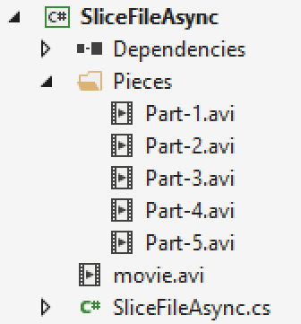
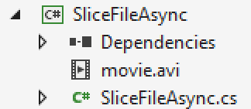
Problem: Slice File
Slice given file into given number of pieces
Save the pieces in a given directory

Slide 32
Solution: Slice a File to Pieces (1)
static void Main(string[] args)
{
string videoPath = Console.ReadLine();
string destination = Console.ReadLine();
int pieces = int.Parse(Console.ReadLine());
SliceAsync(videoPath, destination, pieces);
Console.WriteLine("Anything else?");
while (true) Console.ReadLine();
}

Slide 33
Solution: Slice a File to Pieces (2)
static void SliceAsync(
string sourceFile, string destinationPath, int parts)
{
Task.Run(() =>
{
Slice(sourceFile, destinationPath, parts);
});
}
static void Slice(
string sourceFile, string destinationPath, int parts)
{
// TODO: Implement slice logic
}
Executes on a separate thread

Slide 34


Live Demo: Parallel Image Flips
Read all images from a given directory
Flip the images upside down
Save the flipped images in a given directory

Slide 35
Generic Tasks
Task<T> is a task that will return a result sometime in the future
Task<long> task = Task<long>.Run(() =>
{
long sum = 0;
for (int i = 0; i < 10000; i++) sum += i;
return sum;
});
Console.WriteLine(task.Result);
Blocks the calling thread until the task returns a result

Slide 36
Live Demo: Sum Primes in Range
Sum all prime numbers in given range
Leave the console interface unblocked while calculating the sum
Read commands and print the result only on command "Show"
show
5736397
Print
show
5736397
show
5736397
If the operation time is too long, you will have to wait for the calculations to finish before you can continue reading next command

Slide 37
Task Exception Handling
Exceptions that have occurred within the body of a Task can be captured and handled outside of it
var task = SliceAsync(VideoPath, DestinationPath, 5);
try
{
task.Wait();
}
catch (AggregateException ex)
{
// Handle exception...
}
You can use the AggregateException to wrap all exceptions thrown by different threads

Slide 38
Tasks with async and await
The keywords async and await are always used together
async hints the compiler that the method might run in parallel
Does not make a method run asynchronously (await makes it)
Tells the compiler "this method could wait for a resource or operation"
If it starts waiting, return to the calling method
When the wait is over, go back to called method
static async void SliceFileAsync(string file, int parts)

Slide 39
Tasks with async and await (2)
await is used in a method which has the async keyword
Saves the context in a state machine
Marks waiting for a resource (a task to complete)
Resource should be a Task<T>
Returns T result from Task<T> when it completes
await DownloadStringAsync("http://softuni.bg");
Returns Task<string>

Slide 40
async and await – Example
static void Main()
{
DownloadFileAsync(FileUrl, "book.pdf");
// Do some other work
}
static async void DownloadFileAsync(string url, string fileName)
{
Console.WriteLine("Downloading...");
await Task.Run(() =>
{
// Download the file
});
Console.WriteLine("Download successful.");
}
The calling thread exits the method on await

Slide 41
async and await – Example
static void Main()
{
DownloadFileAsync(FileUrl, "book.pdf");
// Do some other work
}
static async void DownloadFileAsync(string url, string fileName)
{
Console.WriteLine("Downloading...");
await Task.Run(() =>
{
// Download the file
});
Console.WriteLine("Download successful.");
}
When the waiting is over, the calling thread proceeds with method execution

Slide 42
async and await – Example
static void Main()
{
DownloadFileAsync(FileUrl, "book.pdf");
// Do some other work
}
static async void DownloadFileAsync(string url, string fileName)
{
Console.WriteLine("Downloading...");
await Task.Run(() =>
{
// Download the file
});
Console.WriteLine("Download successful.");
}
After the method is over the calling thread gets back to the calling method

Slide 43
Live Demo: Tasks with Async and Await
Execute a long running operation
Handle user input while executing the operation
Hello
You typed: Hello
Hello again
You typed: Hello again
Compute: 588889000
Compute: 588889000
Await
You typed: Await
Compute: 588889000
User input handling
Long running operation result

Slide 44
Build-in Async Methods - GetStringAsync
Access to web resources with HttpClient class
Web access with HttpClient class
File processing with FileStream class
GetStringAsync();
GetAsync();
PostAsync();
ReadAsync();
WriteAsync();

Slide 45
Build-in Async Methods: Get Async
Download a file without blocking the console interface
public static async Task GetAsync(string uri = "https://httpbin.org/get")
{
using (HttpClient client = new HttpClient());
{
using ( var r = await client.GetAsync(new Uri(uri)))
{
string result = await r.Content.ReadAsStringAsync();
Console.WriteLine(result);
}
}
}
Base class for sending HTTP requests and receiving HTTP responses

Slide 46
Build-in Async Methods: Get Async
Download a file without blocking the console interface
public static async Task GetAsync(string uri = "https://httpbin.org/get")
{
using (HttpClient client = new HttpClient());
{
using ( var r = await client.GetAsync(new Uri(uri)))
{
string result = await r.Content.ReadAsStringAsync();
Console.WriteLine(result);
}
}
}
Sends a GET request to the specified Uri

Slide 47
Build-in Async Methods: Get Async
Download a file without blocking the console interface
public static async Task GetAsync(string uri = "https://httpbin.org/get")
{
using (HttpClient client = new HttpClient());
{
using ( var r = await client.GetAsync(new Uri(uri)))
{
string result = await r.Content.ReadAsStringAsync();
Console.WriteLine(result);
}
}
}
Base class representing an HTTP entity body and content headers

Slide 48
Build-in Async Methods: Post Async
Download a file without blocking the console interface
public static async Task PostAsync(string url, string data)
{
HttpClient client = new HttpClient();
StringContent queryString = new StringContent(data);
var response = await client.PostAsync(new Uri(url), queryString);
string responseBody = await response.Content.ReadAsStringAsync();
Console.WriteLine(responseBody);
}
Sends a POST request to the specified Uri with the specified query string

Slide 49
Build-in Async Methods: GetStringAsync
Download the HTML of a given URL
static async Task<string> GetWebsiteHtmlAsync(string websiteUrl)
{
HttpClient client = new HttpClient();
string websiteHtml = await client.GetStringAsync(websiteUrl);
Console.WriteLine("Downloaded html");
return websiteHtml;
}

Slide 50
Build-in Async Methods: ReadAsync
Read a file without blocking the console interface
public static async Task<string> ReadFileAsync(string filename)
{
byte[] result;
Console.WriteLine("Reading...");
using (FileStream reader = File.Open(filename, FileMode.Open))
{
result = new byte[reader.Length];
await reader.ReadAsync(result, 0, (int)reader.Length);
Console.WriteLine("File readed");
}
return System.Text.Encoding.UTF8.GetString(result);
}

Slide 51
Build-in Async Methods: WriteAsync
static async Task SaveFile(string filename, byte[] data)
{
using (FileStream stream = new FileStream(filename, FileMode.OpenOrCreate))
{
int length = data.Length;
await stream.WriteAsync(data, 0, length);
}
}

Slide 52
Example: Download File
Download a file without blocking the console interface
static async Task DownloadFileAsync(string url, string fileName)
{
Console.WriteLine("Downloading...");
using (HttpClient client = new HttpClient())
{
var response = await client.GetStringAsync(FileUrl);
Console.WriteLine("File downloaded");
Task writeFile = SaveFile(fileName, response);
writeFile.Wait();
Process.Start(fileName);
}
}
Opens the downloaded file

Slide 53
Example: Download HTML(1)
Download the HTML of given website without blocking the console interface
static async void GetWebsiteHtmlAsync(string websiteUrl)
{
HttpClient client = new HttpClient();
websiteHtml = await client.GetStringAsync(websiteUrl);
Console.WriteLine("Downloaded html");
}

Slide 54
Example: Download HTML(2)
string url = Console.ReadLine();
GetWebsiteHtmlAsync(url);
while (true)
{
string userInput = Console.ReadLine();
if (userInput == "Print")
{
if (websiteHtml != null) Console.WriteLine(websiteHtml);
else Console.WriteLine("Loading...");
}
else Console.WriteLine("Unknown command. Try again...");
}

Slide 55

Data Parallelism & Concurrency

Slide 56
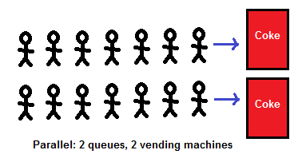
Data Parallelism (Task Parallel Library)
Data parallelism - scenarios in which the same operation is performed concurrently on elements in a collection
The Task Parallel Library (TPL) supports data parallelism through the System.Threading.Tasks.Parallel class
This class provides method-based parallel implementations of for and foreach loops.

Slide 57
Data Parallelism
Parallel.For()
Parallel.ForEach()
var elements = ...; // Some Collection
Parallel.For(0, elements.Length, i => {
Process(elements[i]);
});
var elements = ...; // Some Collection
Parallel.ForEach(elements, item => {
Process(item);
});

Slide 58
Concurrent Collections
The System.Collections.Concurrent namespace provides several thread-safe collection classes
ConcurrentDictionary<TKey, TValue>
ConcurrentBag<T>
ConcurrentStack<T>
ConcurrentQue<T>
Access to the elements of those collections is NOT always guaranteed to be thread-safe.

Slide 59
Parallel LINQ
Parallel LINQ operations can be done
PLINQ is an extension to LINQ to Objects
Not the same as LINQ to SQL!
Just call .AsParallel() on the collection
The compiler does the rest
int[] nums = new int[] { 1, 2, 3, 4, 5 }; var evenNumsParallel = from num in nums.AsParallel() where num % 2 == 0
select num;

Slide 60

TCP Networking
TCP Handshake, TCP Listener and Sockets

Slide 61


Transmission Control Protocol (TCP)
Standard for establishing and maintaining a network conversation
Provides error-free data transmission
The connection is established using a three-way handshake
SYN
Synchronize packet

Slide 62
Transmission Control Protocol
Standard for establishing and maintaining a network conversation
Provides error-free data transmission
The connection is established using a three-way handshake
SYN - ACK
Synchronize
Acknowledgement

Slide 63
Transmission Control Protocol
Standard for establishing and maintaining a network conversation
Provides error-free data transmission
The connection is established using a three-way handshake
ACK
Acknowledgement

Slide 64
Transmission Control Protocol
Standard for establishing and maintaining a network conversation
Provides error-free data transmission
The connection is established using a three-way handshake
Connection Established

Slide 65
TCP Listener
Provides methods that listen for and accept incoming connection requests
private static async Task ServerListen()
{
int port = 8000;
IPAddress ipAddress = IPAddress.Parse("127.0.0.1");
TcpListener server = new TcpListener(ipAddress, port);
server.Start();
// Establish а connection and read request
}

Slide 66
TCP Client
Connecting, sending, and receiving stream data over a network
var client = await listener.AcceptTcpClientAsync();
Console.WriteLine("Client connected.");
byte[] buffer = new byte[1024];
client.GetStream().Read(buffer, 0, buffer.Length);
byte[] data = Encoding.ASCII.GetBytes("Hello!");
client.GetStream().Write(data, 0, data.Length);
client.GetStream().Dispose();
Connecting with client

Slide 67
TCP Client
Connecting, sending, and receiving stream data over a network
var client = await listener.AcceptTcpClientAsync();
Console.WriteLine("Client connected.");
byte[] buffer = new byte[1024];
client.GetStream().Read(buffer, 0, buffer.Length);
byte[] data = Encoding.ASCII.GetBytes("Hello!");
client.GetStream().Write(data, 0, data.Length);
client.GetStream().Dispose();
Reads data from client's NetworkStream

Slide 68
TCP Client
Connecting, sending, and receiving stream data over a network
var client = await listener.AcceptTcpClientAsync();
Console.WriteLine("Client connected.");
byte[] buffer = new byte[1024];
client.GetStream().Read(buffer, 0, buffer.Length);
byte[] data = Encoding.ASCII.GetBytes("Hello!");
client.GetStream().Write(data, 0, data.Length);
client.GetStream().Dispose();
Writes data to client's NetworkStream

Slide 69
TCP Client
Connecting, sending, and receiving stream data over a network
var client = await listener.AcceptTcpClientAsync();
Console.WriteLine("Client connected.");
byte[] buffer = new byte[1024];
client.GetStream().Read(buffer, 0, buffer.Length);
byte[] data = Encoding.ASCII.GetBytes("Hello!");
client.GetStream().Write(data, 0, data.Length);
client.GetStream().Dispose();
Closes the NetworkStream

Slide 70
Socket
Provides methods and properties for network communication
var socket = await listener.AcceptSocketAsync();
byte[] buffer = new byte[1024];
socket.Receive(buffer);
byte[] data = Encoding.ASCII.GetBytes("Hello!");
socket.Send(data);
socket.Shutdown(SocketShutdown.Both);
Connecting with client

Slide 71
Socket
Provides methods and properties for network communication
var socket = await listener.AcceptSocketAsync();
byte[] buffer = new byte[1024];
socket.Receive(buffer);
byte[] data = Encoding.ASCII.GetBytes("Hello!");
socket.Send(data);
socket.Shutdown(SocketShutdown.Both);
Receive data from client

Slide 72
Socket
Provides methods and properties for network communication
var socket = await listener.AcceptSocketAsync();
byte[] buffer = new byte[1024];
socket.Receive(buffer);
byte[] data = Encoding.ASCII.GetBytes("Hello!");
socket.Send(data);
socket.Shutdown(SocketShutdown.Both);
Send data to client

Slide 73
Socket
Provides methods and properties for network communication
var socket = await listener.AcceptSocketAsync();
byte[] buffer = new byte[1024];
socket.Receive(buffer);
byte[] data = Encoding.ASCII.GetBytes("Hello!");
socket.Send(data);
socket.Shutdown(SocketShutdown.Both);
Close connection

Slide 74
Socket
Provides methods and properties for network communication
var socket = await listener.AcceptSocketAsync();
byte[] buffer = new byte[1024];
socket.Receive(buffer);
byte[] data = Encoding.ASCII.GetBytes("Hello!");
socket.Send(data);
socket.Shutdown(SocketShutdown.Both);
Options to disable send/receive

Slide 75
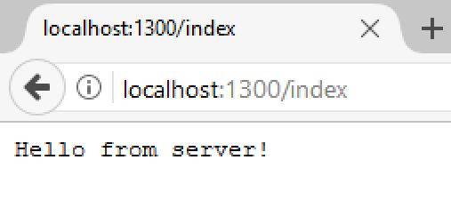
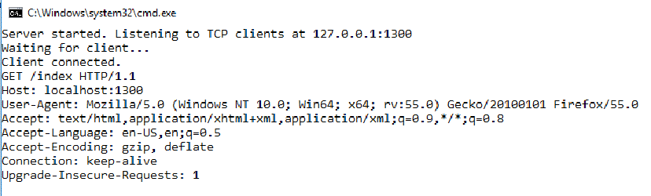

Problem: Simple Web Server
Write a simple web server
Receive a request from a client
Print the request on the console
Write response to client's interface

Slide 76
Solution: Web Server with TcpClient
public async void Connect(TcpListener listener)
{
while (true)
{
// TODO: Accept TcpClient
// TODO: Read request data
// TODO: Send data to client
var message = Encoding.ASCII.GetString(buffer);
Console.WriteLine(message);
client.GetStream().Dispose();
}
}

Slide 77
Solution: Web Server with TcpClient
static void Main()
{
IPAddress address = IPAddress.Parse("127.0.0.1");
int port = 1300;
TcpListener listener = new TcpListener(address, port);
listener.Start();
var task = Task.Run(() => Connect(listener));
task.Wait();
}

Slide 78
Solution: Web Server with Socket
public async void Connect(TcpListener listener)
{
while (true)
{
// TODO: Accept socket
// TODO: Read request data
// TODO: Send data to client
var message = Encoding.ASCII.GetString(buffer);
Console.WriteLine(message);
socket.ShutDown();
}
}

Slide 79

Summary
A thread is a unit of code execution
Each thread has its own call stack
Multithreading
A program can do several parallel operations by using many threads
Used to offload CPU-demanding work so the main thread does not block
Can lead to synchronization issues and unexpected results
Tasks facilitate the work with multithreading
async and await keywords
…
…
…

Slide 80
https://softuni.bg/trainings/courses

Slide 81













SoftUni Diamond Partners

Slide 82





SoftUni Organizational Partners

Slide 83




Trainings @ Software University (SoftUni)
Software University – High-Quality Education and Employment Opportunities
softuni.bg
Software University Foundation
http://softuni.foundation/
Software University @ Facebook
facebook.com/SoftwareUniversity
Software University Forums
forum.softuni.bg

Slide 84

License
This course (slides, examples, demos, videos, homework, etc.) is licensed under the "Creative Commons Attribution-NonCommercial-ShareAlike 4.0 International" license

